Slide 1


Mphasis POV to IDFC AMC
Investor & Distributor Mobile App
Investor & Distributor Web Portals
December 13, 2022

Slide 2





Agenda
01
02
03
Point of View on
Mobile App Platform for Investor & Distributor
Portals for Investor & Distributor
Azure Cloud Components (Production & DR)
Indicative Pricing for
Mobile App Platform for Investor & Distributor
Portals for Investor & Distributor
Azure Cloud Components (Production & DR)
Appendix

Slide 3

1
PoV – Current Application Investor & Distributor

Slide 4
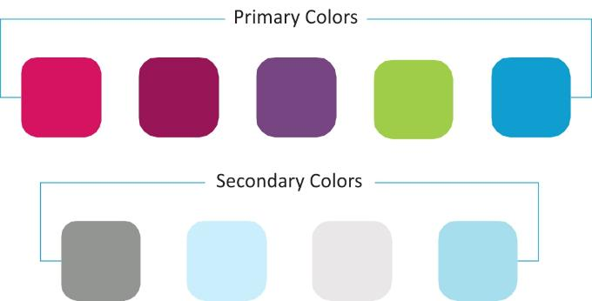

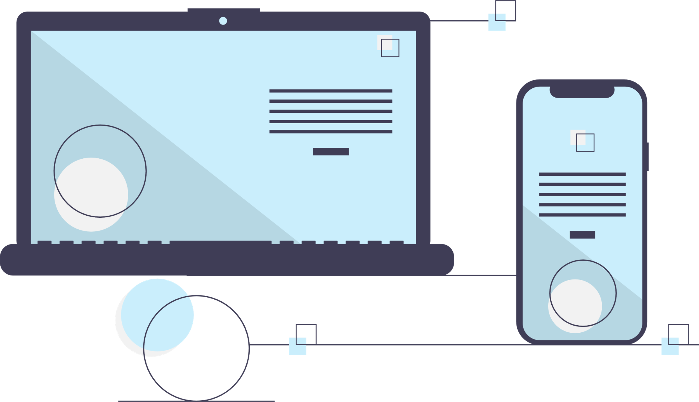

Investor & Distributor Platform - Our Understanding
CURRENT STATE
Currently Web Portal applications for Investor & Distributor are up and running, and covers most required features, but could potentially need a few good to have’s
Distributor Mobile App called “Saathi” is operational but potentially need intuitive features for the users
Experience is something that can be investigated to find out how it can be improved
Applications performances & scalability are on regular check but have observed scaling challenges to meet future growth
Backend Architecture seems simple and straightforward in the first pass
Integration with RTA seems to be working smoothly or at least there have been no complains
NEED FOR A POV ON …
EXPERIENCE
User Research
Experience Design A potential exercise on experience reimagination
ARCHITECTURE
Perform a dipstick analysis of the architecture
Provide a view on future state Architecture

Slide 5
Our Observation & Understanding
ARCHITECTURE:
Observed that the current architecture is a 3-tier architecture, however, our assumption is that this would have evolved from legacy 2 tier technologies like JSP and then migrated to the current technologies over a period.
USER INTERFACE
80+ Web pages constitute the overall functionalities of “Investors” application
75-80% functionalities of the “Investors” application is common for the “Distributor” application & balance 25-20% functionalities are unique
Uses React UI technology to build the web pages
CONTENT STREAMING
Pulling content from web-pages based on the query/ need driven by Drupal
Pushing the content on a regular intervals like financial product, schemes etc.,
BACKEND SERVICES
Most of the backend services are architected as restful services
Some of the services could fetch large number of records from the database
Services developed for “Saathi” app are stable & architected as restful services
PERSISTENCE LAYER
Using direct database connection to fetch required data from the database
REPORTING SERVICES
Based on the requirement the backend service triggers the queries to get the dataset from the database, export it as Excel (CSV)/ PDF and push it to the client through email
EXTERNAL INTEGRATIONS:
Backend services are developed with microservices architecture to consume external API calls from the RTA’s & Payment gateways
LEGACY APPLICATION
Observed that the “Admin” application still in JSP technology

Slide 6



Our Point of View 1/2
ARCHITECTURE
A layered architecture provides a clean-cut interface so that minimum information is shared among different layers. It also ensures that the implementation of one layer can be easily replaced by another implementation.
Transformation of restful services in to light wight microservices would be a great way to move forward.
Basically, disassembling legacy code and breaking it up into standalone code elements that will run as microservices.
Unless one modernizes those monolithic applications to be cloud-native, they end up requiring very large machines and often end up paying more to the cloud providers.
Unless one transforms those monolithic code blocks in to microservices/ cloud-native, business will end up requiring very large machines and often end up paying more to the cloud providers.
To get the full benefit of cloud implementation & deployment, one need to adopt the required standards & modern design principles.
USER INTERFACE
Building a UI framework specific for IDFC would be advisable, need to invest time to understand the domain and design based on the domain specification, this could be leveraged across the applications, Investor & Distributor Mobile App and Portals.
User Interface Design patterns are recurring solutions that solve common design problems. Design patterns are standard reference points.
Use UI design patterns & principles, would help re-use of these assets across all the applications.
BACKEND AS A SERVICE (BAAS)
Implementing BaaS architecture would help the developer to outsource all the behind-the-scene aspects of developing web application, only they have to develop and maintain the front-end.
BaaS vendors provide pre-written software for activities that take place on servers, for example;
Database management
Cloud storage (for user-generated content)
User authentication
Push notifications
Remote updating
Hosting

Slide 7





Our Point of View 2/2
MOBILE BACKEND AS A SERVICE (MBAAS)
Implementing mBaaS – mobile backend as service for mobile application would easily link the mobile applications to backend cloud storage and other API’s, for instance, Firebase offers Google search indexing
PERSISTENCE LAYER
It is necessary to build persistence layer, especially for a large implementations like IDFC, the idea of persistence layer is to encapsulate databases access routines. This helps the applications to work with a set of objects (Data Objects) that read and save their state to the database; therefor applications do not need to have it in their source code SQL statements.
EXTERNAL INTEGRATIONS: PLUG & PLAY PLATFORM
A platform that could easiest Plug and Play Integrator that makes development, deployment and management of Data Transformation easy to build and manage.
LEGACY APPLICATION
Better to migrate the legacy application to the modern architecture/ technology, which would help & ease the maintenance and eradicate all security related issues

Slide 8

2
Potential Future State

Slide 9








Multi-Channel Platform for Investors & Distributors (Web and Mobile)
1. Single App Platform for Investor & Distributor
2. Create respective accounts with ease
Discover
3. Discover the product information, scheme listing
4. Strategise your finances with calculators and valuations
Mobile APP Platform
Track
Plan
5. Recommendations to capitalize on market conditions
6. Facilitate transactions to grab investment opportunity on the go
Transact
7. Keep track of all your investments /transactions within seconds
8. View/ Download capital gain, statements through simple click

Slide 10




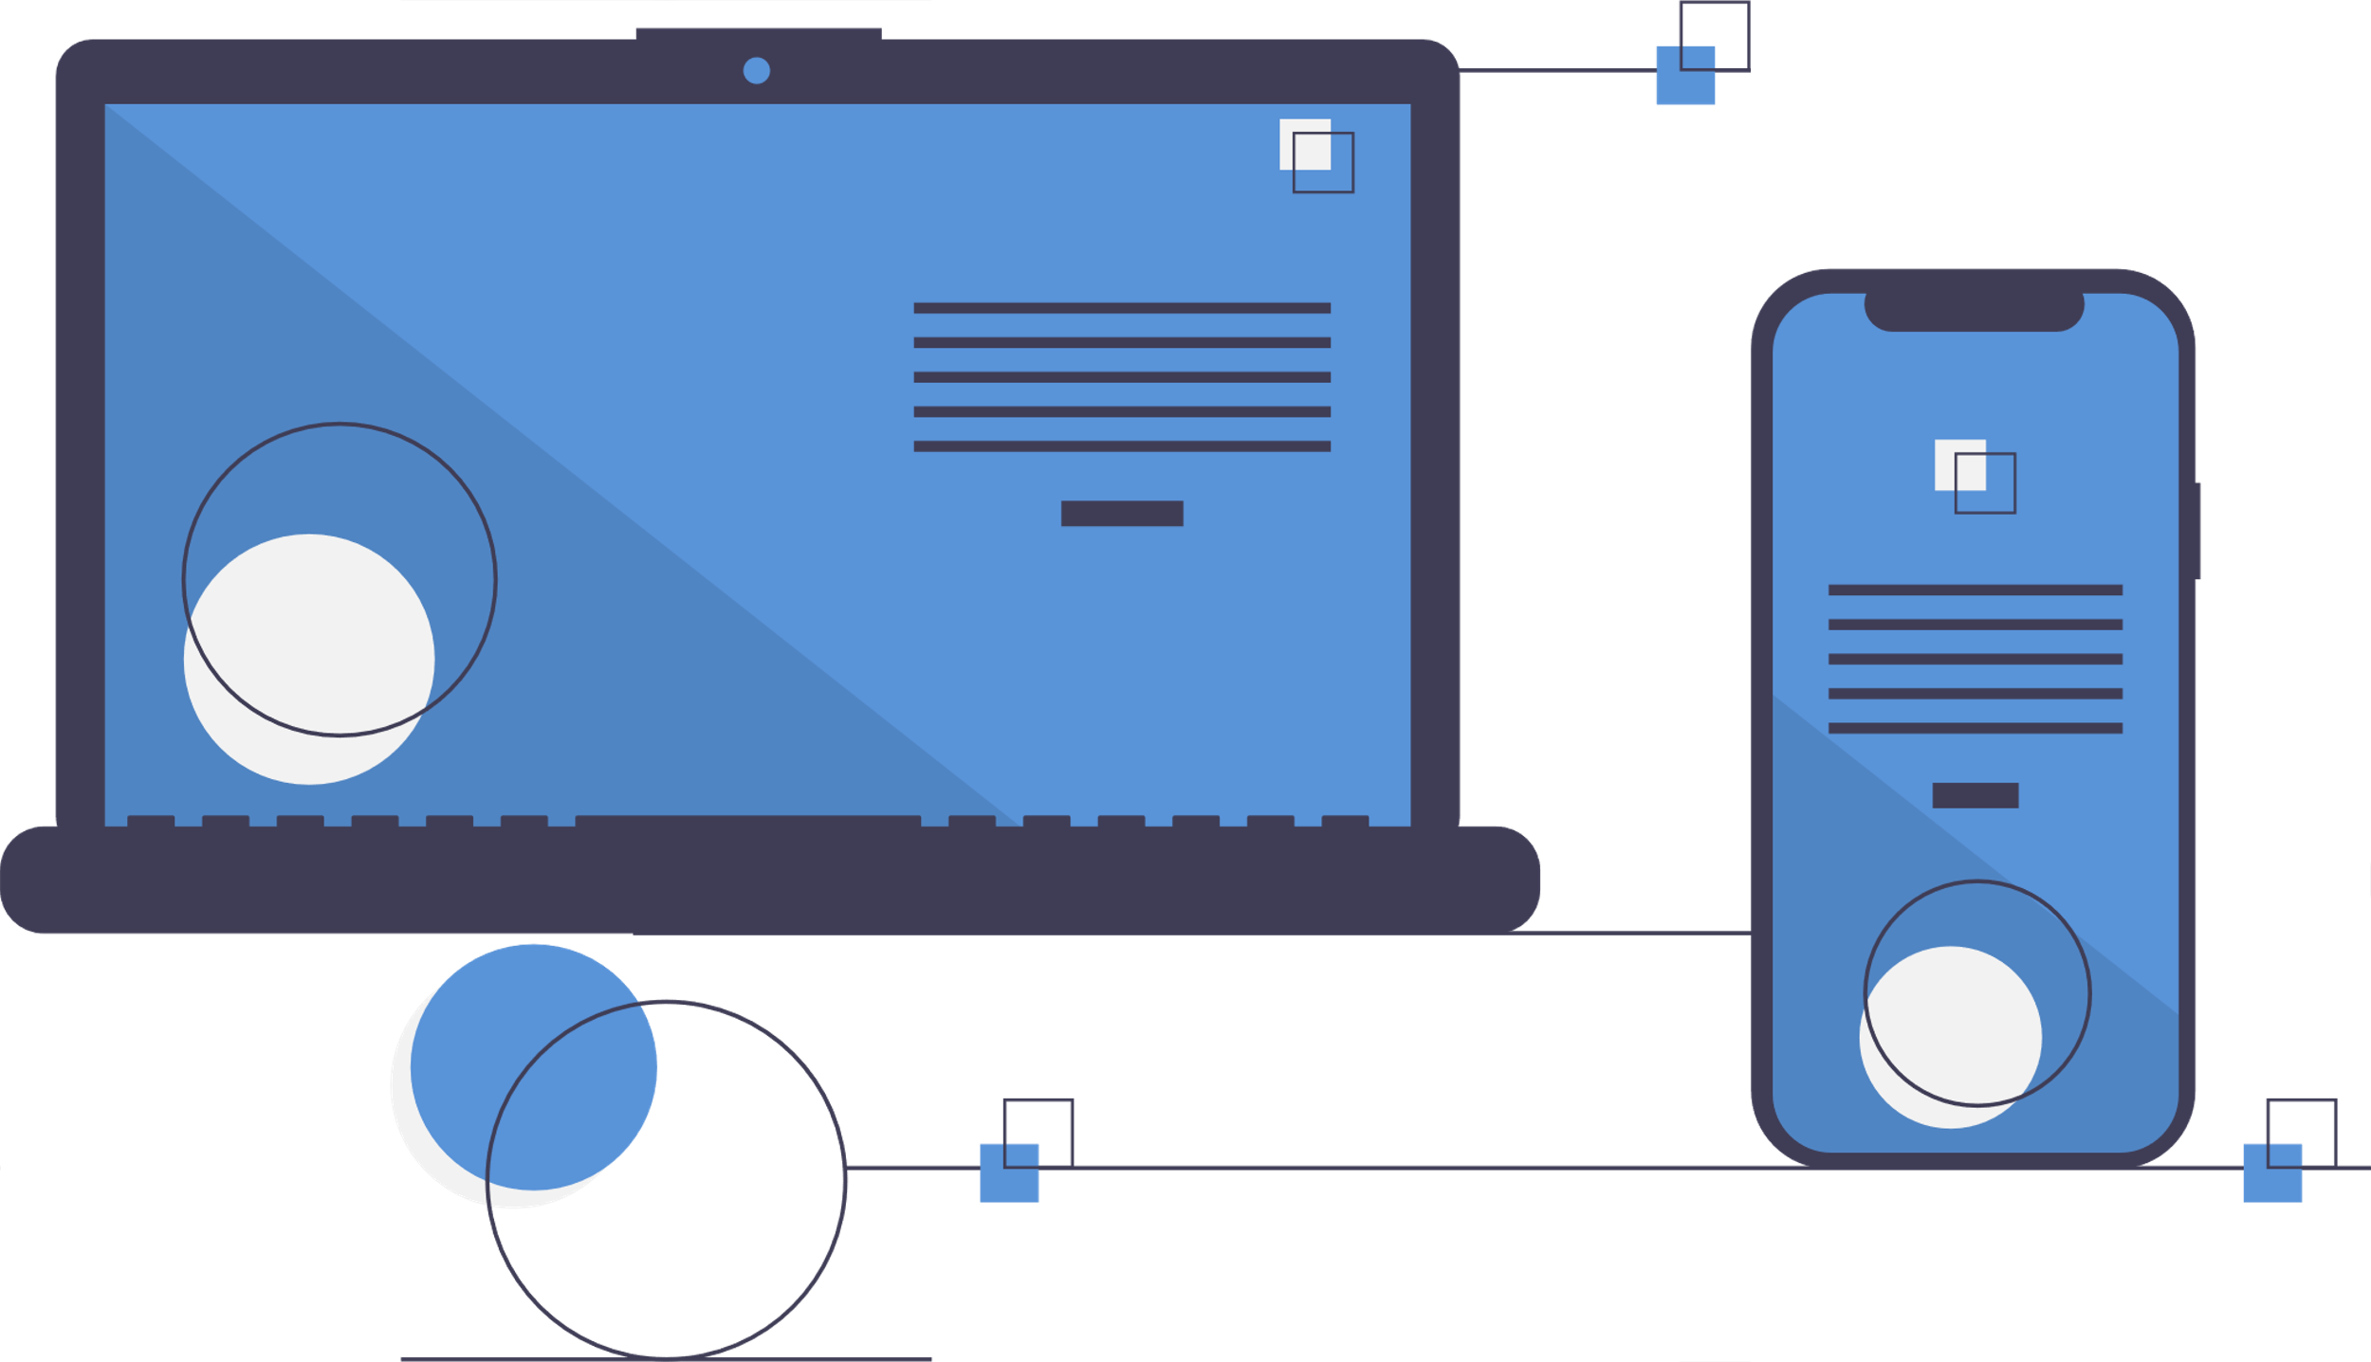
Solution Platform View
FinTech
Future
Need
External APIs
Now
Next
Later
Next
Current
Requirement
Corporate Website
Investor
App
Investor
Web
Distributor
App
Distributor
Web
API Layer
Authentication & Access Control
Investor Journeys
Distributor Journeys
Calculators
Insights
Digital Platform
Content
Data
Integrations
Services
Payments
RTA
Others

Slide 11


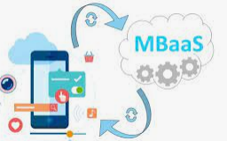


















Target Architecture for Investor / Distributor Application with DR
Passive Env
Internet Layer
Load Balancer Layer
Chennai
Active Env
Geo Replication
Pune
<<API Management>>
Application Gateway
Portal URL
Investor
Distributor
VPN Data Gateway
External Interfaces – Platforms
Azure Front Door + Azure Firewall
App Layer
Business Layer
Data Layer
Misc. Layer
Azure DBs
App Containers
IDFC BI - DB
Mobile App
Investor
Distributor
Redis Distributed Cache (Stateful)
Domain Micro Services
Campaign Manager
Transaction Logs
Application
Gateway
RTA
Replication
CI/CD Pipeline
Native Apps Calling API Directly
CI/CD Pipeline
Monitoring
Identity & Access Management
Security

Slide 12


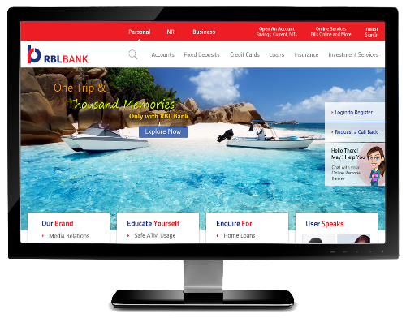

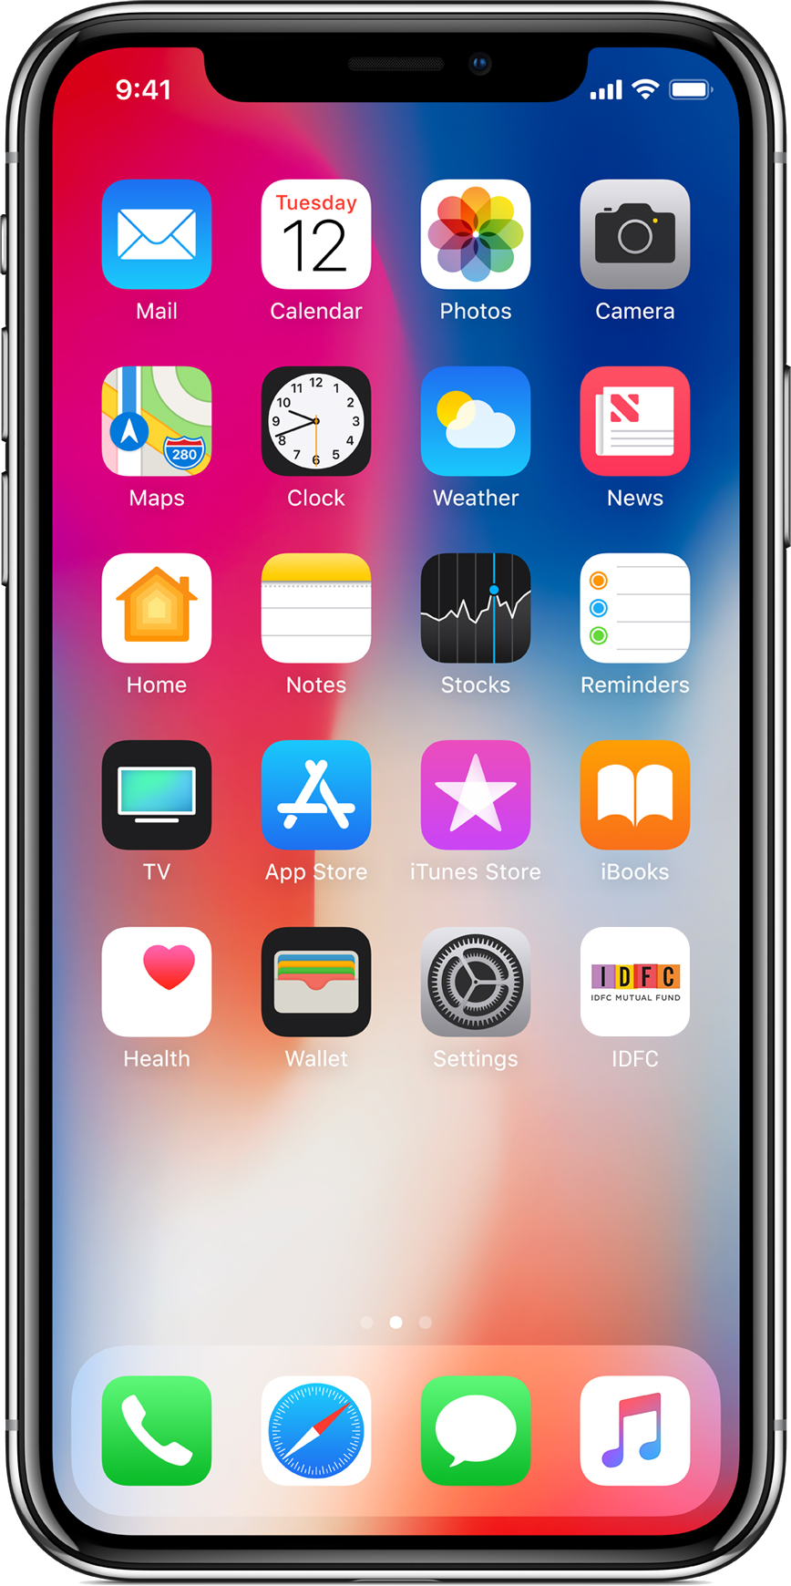
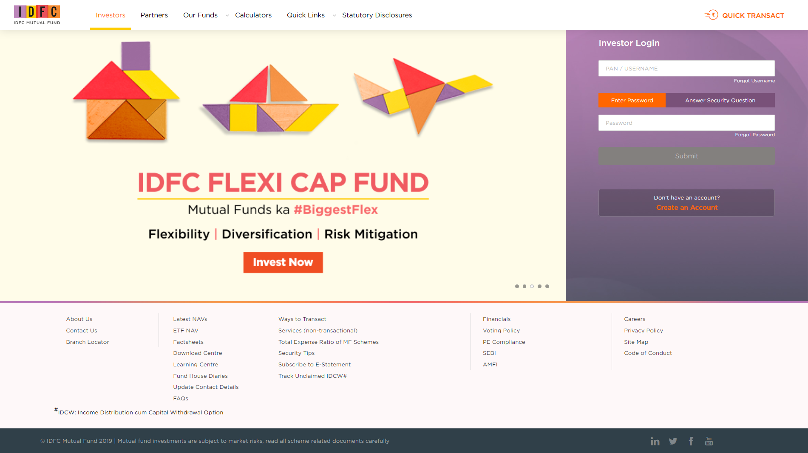
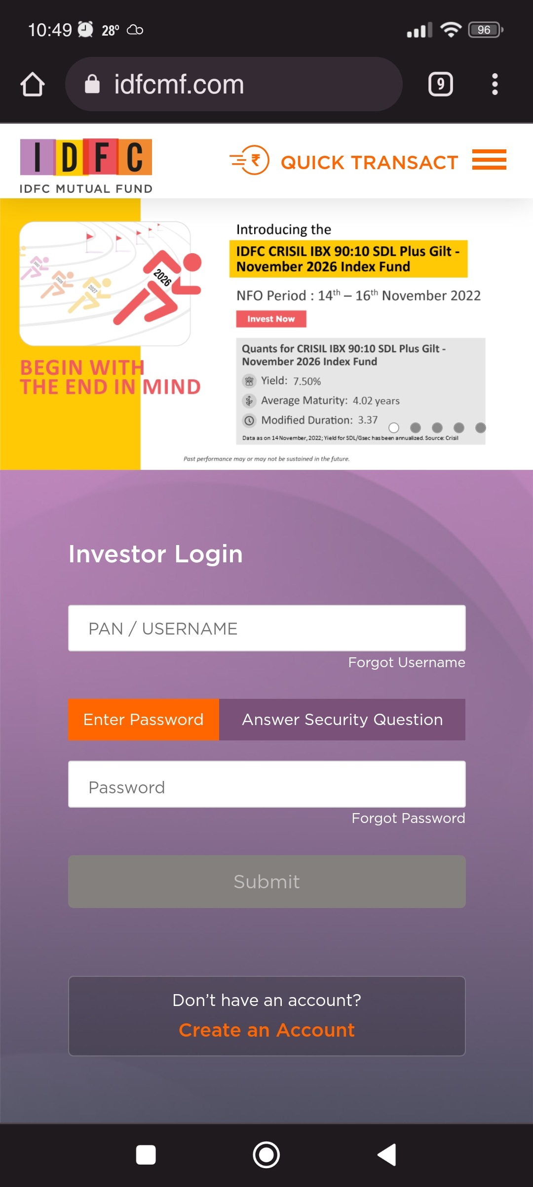
Defining the Tenets for Reimagining The Experience for the Brand
Reimagining IDFC AMC to offer an Omni-Channel Experience
Experience redefinition for the current web and native design assets
Responsive Portal Experience
Native Assets
Leverage User Experience / Journey Maps to iteratively design UX prototypes and test them at identified intervals
Refine the proposed interaction through formal User Tests
KEY TENETS
Conducting a Design Workshop to Ideate and Reimagine the “To-Be” Experience Design for assets under consideration
Work closely with the Digital and Marketing teams to ensure alignment with the business objectives
SCOPE OF WORK
Experience Research
Design Workshops
Experience Design
Experience Development
Experience Testing
KEY OUTCOMES
Product Backlog
Design Directions
User Journey Maps
Design Prototypes
User Testing Report

Slide 13
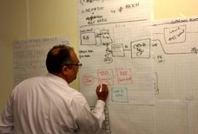
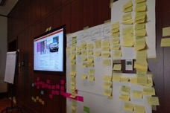
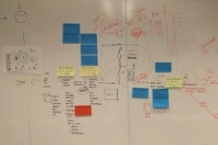
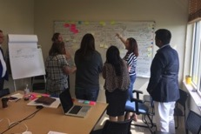
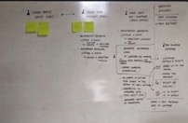
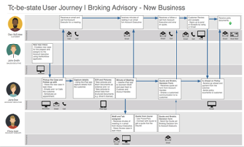

User Research Phase - Activity and Outcomes
DESIGN THINKING WORKSHOP (Conducted In-Person)
User and Experience Research
DESIGN THINKING WORKSHOP
Deliverables
Product Backlog for all key modules
Catalog of Ideas with Prioritization
Program Timelines
To-Be User Journeys
Directional Visual Designs
Design Directions
Key Input to the Workshop
All User Insights received during the workshop
Current Journey Maps
Reimagined Journey Maps
Rapid Prototyping Testing
Roadmap and Architecture

Slide 14
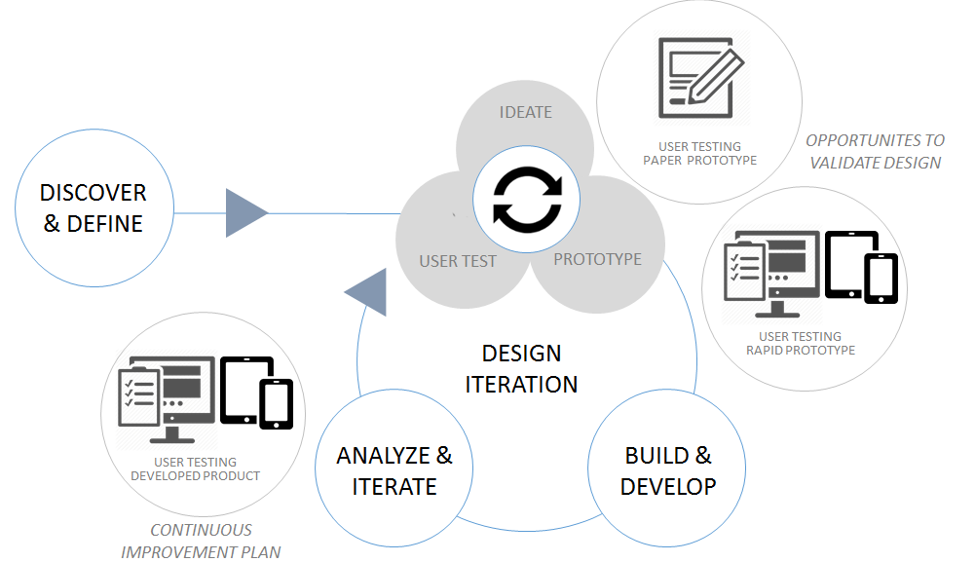
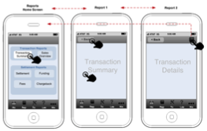
Experience Design and Development
USER RESEARCH PHASE
S1
S2
S3
S4
S5
S6
S7
S8
…………………..
Sn
Continuous Experience Improvement Activities
Sprint 1 through Sprint 8: Across all the Sprints, the following UX / UI activities will be considered – Wireframing , Visual Design and Web Development.
Lo-Fidelity / Hi-Fidelity Prototypes
Visual Design Mock-Ups
User/Usability Testing
Front-End Development
Conducted User Tests at the following points in UX lifecycle:
-Post Wireframing
-Post Visual Designs
- Define App Architecture
- Determine common and reusable components
Deliverable:
Responsive Design Prototypes through Wireframes
Tools Used: Figma / Sketch
Deliverable:
Production-ready Visual Design Mock-ups
Design Prototype ready for User Testing
Tools Used: Figma / Sketch
Deliverable:
User Tests Report
Updated Prototypes and Product Backlogs
Tools Used: WebEx / Teams
Conducted : In-person and Remote
Deliverable:
Responsive React Application
Unit test cases
Documentation
Tools Used: IDE (VS Code)
Techstack: NodeJs, React, Webex, HTML5, CSS3, React Testing Library ..
14-12-2022 | © Mphasis 2019 Proprietary and confidential information
14

Slide 15
Indicative Execution Plan
Foundation 3 weeks
M1
M2
M3
M4
M5
M6
M7
M8
Agile
Sprints
Sprint 1
Sprint 2
Sprint 3
Sprint 4
Sprint 5
Sprint 6
Sprint 7
Sprint 8
Sprint 9
Sprint 10
Sprint 11
Sprint 12
Sprint 13
Sprint 14
Sprint 15
Sprint 16
Due Diligence / Requirement Analysis & Design Preparation
Launch 1
Release # 1
User Stories & Backlog Grooming -Develop > Test > Deploy
Investor Portal + Mobile App (APIs + Services)
Launch 2
Release # 2
User Stories & Backlog Grooming -Develop > Test > Deploy
Distributor Portal + Mobile App (APIs + Services)
Launch 3
Release # 3
User Stories & Backlog Grooming -Develop > Test > Deploy
Distributor Portal + Mobile App (APIs + Services)
Key Points :
Release # 1 – Investor Portal + Mobile App*
User Account
Products
NFRs
Interactions Recordings
Integration with CMS, BI, CRM, Campaign Manager & Replication Server
Business
Payment
Transactions
Transaction Summary
In App Events
Support Basic Integration with selected IDFC Systems & data API
Key Points :
Release # 2 – Distributor Portal + Mobile App*
Account Management
Service Requests
Notifications
Systematic Corner
Integration – Embedded videos from YouTube, Deep-Linking, Customer Services
Support Basic Integration with selected IDFC Systems & data API
Release # 3 – Distributor Portal + Mobile App*
Online onboarding
Distributors Segmentations & Bifurcations
Engagement & Campaign Management
Integration for Webinars & online Event Management
* This is and indicative plan. Releases and Functionality covered in each release will be jointly arrived along with IT and Business teams

Slide 16
Indicative Commercial
Approach to Build Platform Grounds-up for Investor & Distributor Mobile App & Portals
Inclusions | Indicative Price (INR) | Assumptions
Reimaging and remediate Web Portals for Investor & Distributor to provide an Omni-Channel Experience Experience design for Mobile interface (iOS & Android) Implement required changes to the Web UI Design and Build Mobile App Platform for Investor & Distributor functionalities Implement required MBaaS using Firebase Implement API Gateway Design and build Platform Architecture Develop required additional APIs Functional Automated & Manual testing the App on multiple devices Performance Testing | Currently estimated price for Investor & Distributor Mobile App & Portal is in the ballpark of INR 5.57 Cr. *These are high level ballpark estimates & pricing. The firm pricing can be provided basis a formal detailed due-diligence exercise and be higher or lower than the above price | Have considered functionality only for mobile app and portals for Investor & Distributor Factored 80 Web Pages based on information shared Assumed 75-80% functionalities of the “Investors” application common for the “Distributor” application & balance 25-20% functionality is unique, as shared on the call Some UI code re-use is considered for code not impacted by VD and IA Reuse existing RTA API code as is All APIs currently consumed by “Saathi” mobile app is available for reuse Drupal to Sitefinity replacement will be assessed during due diligence phase and remediated as necessary Moving away from Oracle will be assessed during due diligence phase Warranty support of 4 weeks post go-live No additional functionality assumed
Investor_Distributor_App_EstimateCosting_DEV Investor_Distributor_App_EstimateCosting_PROD | DEV - USD 5,744/Month PROD - USD 13,396/Month | Considered Azure components relevant for the proposed future state architecture for IDFC-AMC Volume details are assumed which will be revised to arrive to actuals during solution design phase which may result in price revision
Notes:
Implement Mobile Backend Service (mBaaS – Firebase) to provide Notifications, Authentication Integration, Firebase Analytics & Crashlytics services to Mobile App

Slide 17

3
Appendix

Slide 18
Key Assumptions & Dependencies 1/2
A single app is considered with Investor and Distributor as two separate roles signing in
Mobile App will be supported on devices with Android API Level 21 and above & iOS 11 and above
Most of (around 80%) UI features are same for Investor and Distributor. Distributor has additional features as provided by IDFC
MBaaS platform (Google Firebase) is considered for Mobile Backend services
Mobile devices cost or the cloud devices cost to be separately factored if not provided by Client
No major UI/flow differences in main Transactions, Login processes and product listing for Investor and Distributor roles
Any licensing cost for the hardware and software/SDKs (if any) are to be provided by IDFC team
The solution is based on a Cross Platform framework for mobile app UI development for iOS and Android. Proposed framework is ReactNative, but Flutter can also be considered if so preferred
All Existing Backend APIs will be available for consumption by Mobile UI.
CMS integration is considered with as-is rendering of contents, media and reports
Only two mobile devices per platform are considered for the testing and certifying the app on iOS and Android

Slide 19
Key Assumptions & Dependencies 2/2
Solution is based on Geo Replication for all the layers of the application
New backend services will be developed to provide additional features for seamless
Geo replication is enabled for Application , Business , Middle tier and DB layer for Pune and Chennai
experience between mobile and portal, session management, notification services
Mphasis team members will have flexibility to operate out of different work locations (given ongoing pandemic situation). Resources will follow IDFC AMC holiday calendar
Mphasis resources are eligible to take 2 days leave in a month. Leave plans would be informed to IDFC AMC
Active – Passive Topology is enabled at all the layers
Load Balancer would be enabled with Azure Front Door capability to support Geo Replication
Azure PaaS DB Services ensure the Geo Replication and High Availability
Services needs to be Aligned for the Geo Replication is available only for Pune and Chennai
The current backend services will be retrofitted to the new platform architecture

Slide 20
Point of view with respect to going with “Only building Investor Mobile App.”
Quick go to market strategy & to retain the customer
Need to focus & develop only mobile application and use the existing assets for accessing the data & to perform required transactions.
PROS
May need to deal with performance & scalability issues, because the backend restful services to be optimized for better data handling
May end-up with many duck-tape solutions like;
Data massaging
Develop intermittent layer to hand-shake with the restful services, especially extending few methods need special validations & adoption
Does not guarantee an intuitive user experience
CONS

Slide 21
Current Arch vs Option 1 vs Option 2 …
Current Architecture | Option 1: Investor mobile app (only UI to be build) | Re-Usability: Current Web assets | Option 2: Building Platform | Re-Usability: Option 1 Assets
UI/ UX Tech:
React – 80+ web pages (Responsive Design) | Partial | 10%-15% | Rebuild the entire UI for better & intuitive user experience | 10%-15%
Middleware Tech:
Restful Services | Connecting the Mobile app with the restful services, may results in performance lagging to fetch large size data.
 | May end up in developing few or a greater number of back-end services (light weight Web API) for better user experience, business flow orchestration, performance, scalability & code management |  | Build light weight microservice architecture | 100%
API Micro Services - (10) |  | 100% |  | 100%
3rd Party Integrations | AS IS | 100% |  | 100%
Data Layer Tech:
Connection using JDBC Template (Assumption) |  |  | Build persistence layer
Database:

Slide 22
About Mphasis
Mphasis (BSE: 526299; NSE: MPHASIS) applies next-generation technology to help enterprises transform businesses globally. Customer centricity is foundational to Mphasis and is reflected in the Mphasis’ Front2Back™ Transformation approach. Front2Back™ uses the exponential power of cloud and cognitive to provide hyper-personalized (C=X2C² _{TM}=1) digital experience to clients and their end customers. Mphasis’ Service Transformation approach helps ‘shrink the core’ through the application of digital technologies across legacy environments within an enterprise, enabling businesses to stay ahead in a changing world. Mphasis’ core reference architectures and tools, speed and innovation with domain expertise and specialization are key to building strong relationships with marquee clients. Click here to know

